Slide 1

Domestic Aid & Surveillance through Raspberry Pi
Supervised By:- Prof. Deepak Nagaria
Submitted By-
Prashant Kushwaha (1704331036)
Saurabh Singh (1704331047)
Atul Tomar (1704331016)

Slide 2
Contents
Introduction
Objectives
Literature Review
Problem Identification
Methodology
Schematic Circuit Diagram
Block Diagram
Result & Discussion
Conclusion
References

Slide 3
Introduction
A home automation system can monitor and/or control home attributes such as lighting, climate, entertainment systems, and appliances.
Smarter home and surroundings can be achieved through the interfacing different kinds of sensors .
It also include home security such as access control and alert systems.

Slide 4
Objectives
Provides better care to family
Improved productivity
Helps in reducing power consumption
Helps in developing secure domestic environment

Slide 5
Literature Review
S. No. | Authors, Title | Publication Details | Key Findings
1. | Nadaf R.A., Hatture S., Challigidad P.S., Bonal V.M. (2019) Smart Mirror Using Raspberry Pi for Human Monitoring and Home Security. | Luhach A., Jat D., Hawari K., Gao XZ., Lingras P. (eds) Advanced Informatics for Computing Research. ICAICR 2019. Communications in Computer and Information Science, vol 1076. Springer, Singapore. | Any human intrusion can be monitored and user can be alerted.

Slide 6
Problem Identification
There is not any model available which provides surveillance and switching capabilities simultaneously.
Various available systems aim at single task only.

Slide 7
Methodology
We are using Raspberry Pi (Model B+) board, which is quite fast.
We can interface sensors (like temp. sensors, PIR sensors and Camera, etc.) to gather data to give optimized output.
Setting up the server.
Handling data(s) through web-application.

Slide 8
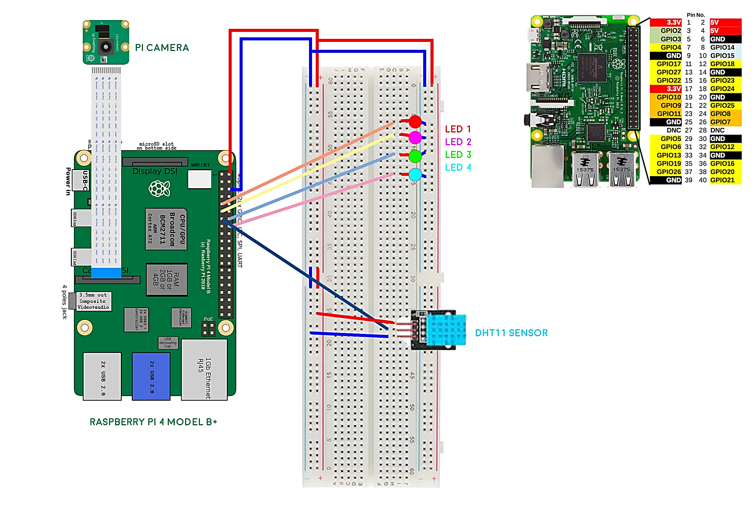
Schematic Circuit Diagram

Slide 9
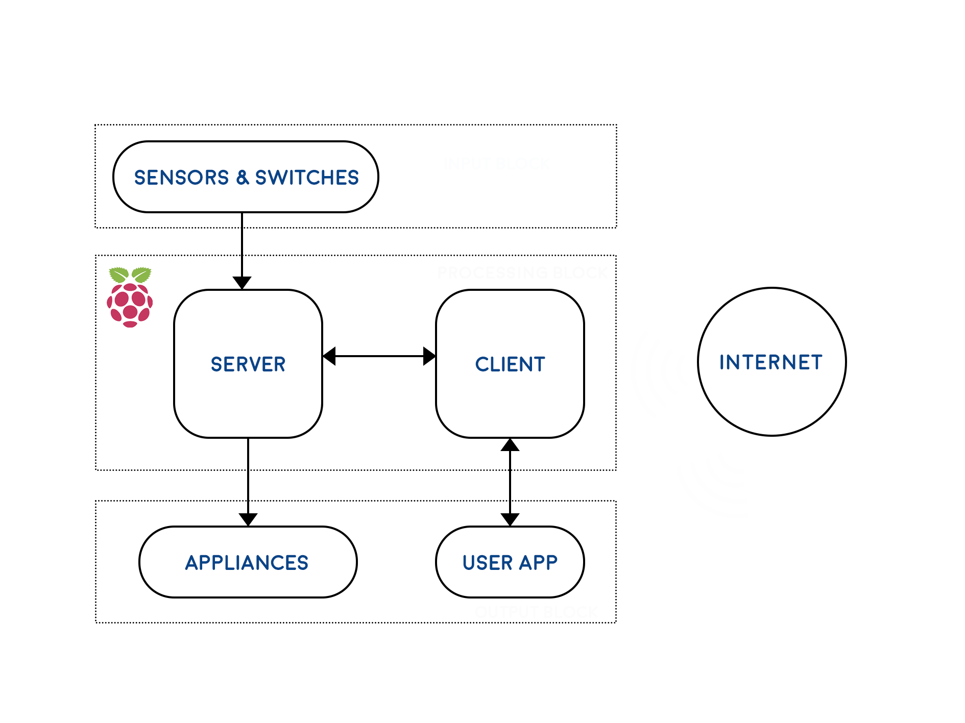
Block Diagram

Slide 10
Results & Discussion
This project is undeniably a resource which can make a home environment automated.
We are able to keep track of any intrusion within our premises quite easily.
Project like this come with a huge potential in marketing sector.

Slide 11
Results & Discussion
Criterion | Domestic Aid & Surveillance | Smart Mirror (base) | Various Available Home Automation Projects | Various Available Surveillance / Security Systems
Remotely Accessible | Yes | Yes | Yes | Yes
Circuit Controllability | Yes | No | Yes | No
Circuit Monitoring | Yes | No | Yes | No
Streaming | Yes | No | No | Yes
Reliability | Yes | Yes | Yes | Yes

Slide 12
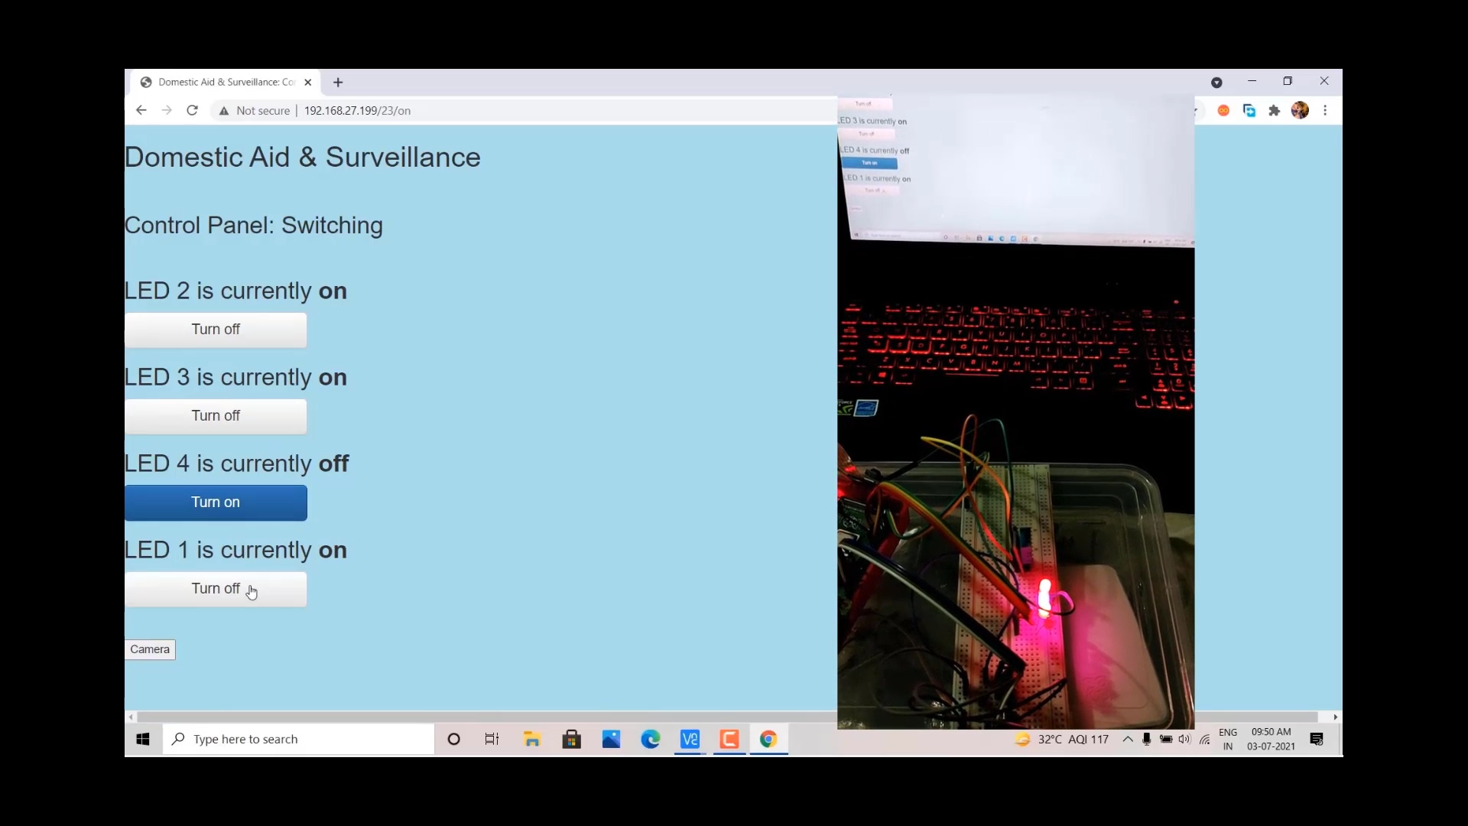
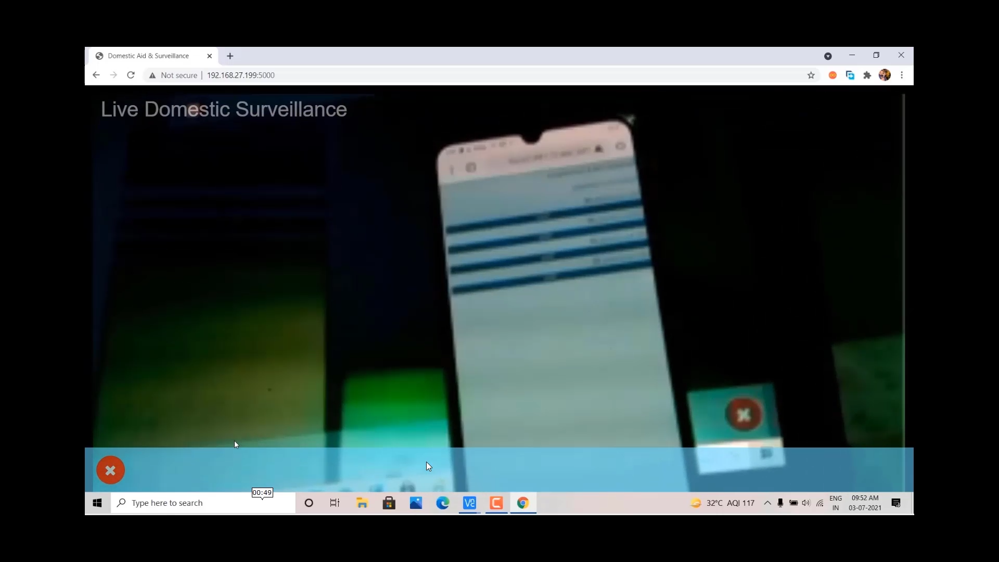
Sample Output

Slide 13
Conclusion
Interoperability:- Ability to tie diverse electronic devices together so they can perform as one unified system.
Remotely Accessible
Upgradability
Variety of User Interfaces

Slide 14
References
Dahoumane T., Haddadi M. (2018) Smart Home Control System Based on Raspberry Pi and ZigBee. In: Hatti M. (eds) Artificial Intelligence in Renewable Energetic Systems. ICAIRES 2017. Lecture Notes in Networks and Systems, vol 35. Springer, Cham.
Nadaf R.A., Hatture S., Challigidad P.S., Bonal V.M. (2019) Smart Mirror Using Raspberry Pi for Human Monitoring and Home Security. In: Luhach A., Jat D., Hawari K., Gao XZ., Lingras P. (eds) Advanced Informatics for Computing Research. ICAICR 2019. Communications in Computer and Information Science, vol 1076. Springer, Singapore. https://doi.org/10.1007/978-981-15-0111-1_10

Slide 15
Thank You!

